Slide 1
Logic Design by MOS Gates

Slide 2
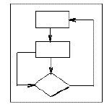
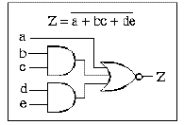
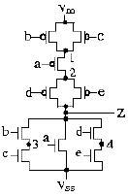
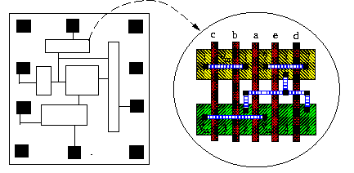
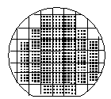

VLSI Design Flow
System Specification
functional simulation
specification
Function/architecture Design
logic simulation
behavioral representation
Logic Synthesis
circuit analysis
structural representation
Circuit Design
extraction & verification
structural representation
Physical Synthesis
physical representation
Fabrication
Packaging

Slide 3
VLSI Design Flow
System Specification
functional simulation
specification
Function/architecture Design
logic simulation
behavioral representation
Logic Synthesis
circuit analysis
structural representation
Circuit Design
extraction & verification
structural representation
Physical Synthesis
physical representation
Fabrication
Packaging

Slide 4
Conduction Complement
Complementary CMOS gates always produce 0 or 1
Ex: NAND gate
Series nMOS: Y=0 when both inputs are 1
Thus Y=1 when either input is 0
Requires parallel pMOS
Rule of Conduction Complements
Pull-up network is complement of pull-down
Parallel -> series, series -> parallel
V_{DD}
A
B

Slide 5
Realization by NAND Gates
V_{DD}
AND-AND-OR-INV
V_{DD}
V_{DD}
A
Y
B
V_{DD}
A
B
Y
C
C
D
D

Slide 6
CMOS Gate Design
CMOS NOR gate
V_{DD}
A
B

Slide 7
Realization by NOR Gates
V_{DD}
V_{DD}
AND-AND-OR-INV
A
V_{DD}
V_{DD}
B
Y
Y
V_{DD}
V_{DD}
C
V_{DD}
D
A
B
C
D

Slide 8
Complementary CMOS (single complex cell)
Complementary CMOS logic gates
nMOS pull-down network
pMOS pull-up network
a.k.a. static CMOS
Pull-up OFF
Pull-up ON
Pull-down OFF
Z (float)
1
Pull-down ON
0
X (crowbar)

Slide 9
Series and Parallel
nMOS: 1 = ON
pMOS: 0 = ON
Series: both must be ON
Parallel: either can be ON

Slide 10
Compound Gates
Compound gates can do any inverting function

Slide 11
Example:
V_{DD}
LOAD
AB
V_{DD}
A
V_{DD}
LOAD
B
Y
A
C
Y
A
C
V_{DD}
LOAD
B
D
B
D
CD
C
D

Slide 12
Example:
V_{DD}
V_{DD}
A
B
V_{DD}
AB
A
B
LOAD
A
B
C
D
V_{DD}
Y
C
D
Y
C
D
CD
LOAD
LOAD

Slide 13
Example:
V_{DD}
LOAD
Y
A
C
V_{DD}
A
B
B
D
C
D
Y
V_{DD}
A
C
A
B
B
D
C
D
Y
LOAD

Slide 14
Several Realizations: NMOS
Y= AB + CD =AB + CD =(A+B)(C+D) =A C + B C + A D + B D
=(A +C)(B +C)(A +D)(B +D)
A
C
A
C
B
D
B
C
A
D
Series-Parallel (SP)
B
D
Parallel-Series (PS)

Slide 15
Several Realizations: PMOS
Y = AB + CD = ( A+B ) ( C+D )= A C + B C + A D + B D
A
B
A
B
A
B
C
D
C
C
D
D
Parallel-Series (PS)
Series-Parallel (SP)

Slide 16
Different single complex cell designs using CMOS
V_{DD}
V_{DD}
A
B
A
B
A
C
C
C
D
D
B
D
Y = AB + CD
Y = AB + CD
A
C
C
A
B
C
C
B
A
D
D
A
B
D
D
B
SP-PS
PS-PS

Slide 17
Different single complex cell designs using CMOS
V_{DD}
V_{DD}
A
B
A
B
A
B
C
C
D
D
C
D
Y = AB + CD
Y= AB+CD
A
C
A
C
B
D
B
D
SP-SP
PS-SP

Slide 20
How to optimize the circuit ?
The question of delay, power, space
Two level gate level optimization
Multilevel gate level optimization
Optimization with respect to transistors
Optimization with respect to space in fabrication of Integrated circuits

